Slide 1
Template – copy this slide
Point example
Static
Stack
point_counter
2
id_counter
1002
x
6
m
y
8
id
1001
x
9
n
y
8
AR
main
id
1002
no args
x
a
x
x
this
x
x
x
x
x
x
x
a
x
x
Unsafe Memory
x
x
x
x
x

Slide 2
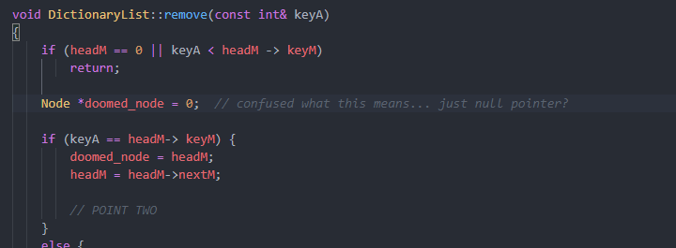
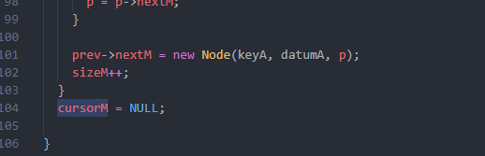
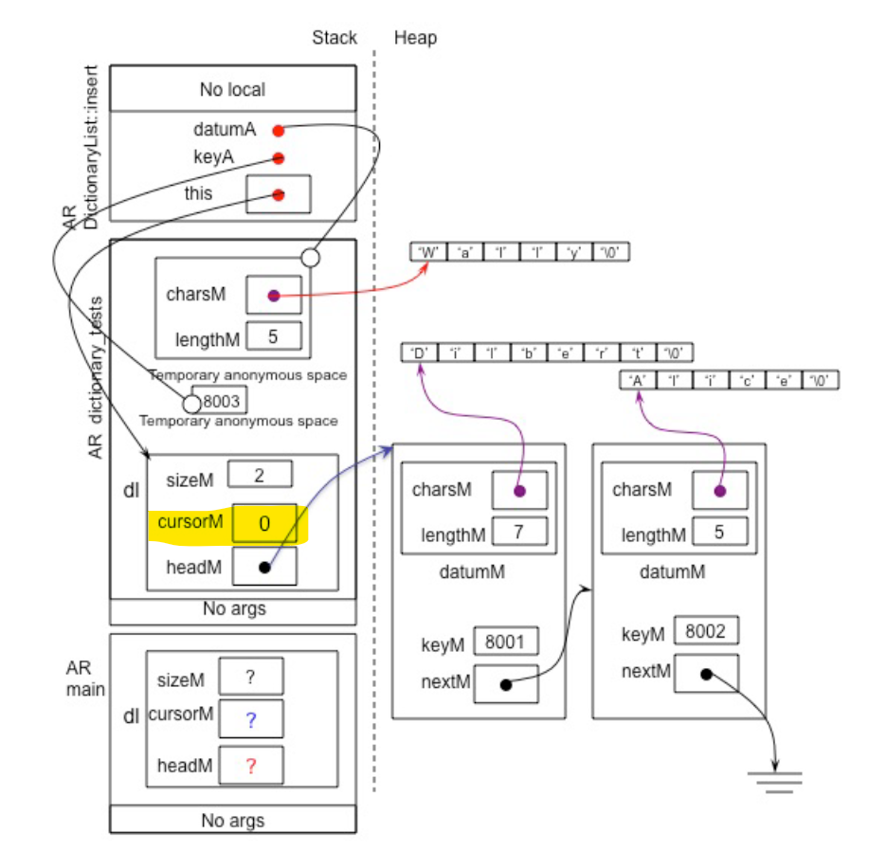
Template – copy this slide
Point 2 Question 1
Stack
Heap
doomed_node
AR dictionary::remove
keyA
This good to draw doomed_node?
this
8002
Temporary Anonymous Space
Should cursorM be null in diagram given?? End of insert is this
sizeM
3
dl
cursorM
AR dictionary_tests
headM
no args
‘D’
‘A’
‘W’
sizeM
?
‘i'
charsM
‘l'
charsM
‘a'
charsM
dl
‘l’
‘i’
‘l’
AR
main
cursorM
?
‘b’
lengthM
7
‘c’
lengthM
5
‘l’
lengthM
5
headM
?
‘e’
datumM
‘e’
datumM
‘y’
datumM
‘r’
‘/0’
‘/0’
‘t’
keyM
8001
keyM
8002
keyM
8003
‘/0’
nextM
nextM
nextM
no args
x
a
x
this
x
x
Unsafe Memory
x
x
x
x
x
x
x
x
x
a
x
x
x
x

